Slide 1
AS91883(1.7) & AS91884(1.8) Documentation
[overtype this with your name]

Slide 2
[Overtype this with your program name]
Link to GitHub Repository: [here]
Links to Trello board / project management tools: [here]
Link to final version of your program: [here]
Ensure you have made these links ‘public’ so that they are open to anyone, including the marker. The link to your program is the final outcome of this whole project – your finished program.

Slide 3
Describe relevant Implications:
Additional rows can be added by clicking in the last cell and then using the Tab key
Relevant implication | Describe the implication and give an example
Function | The program that I will be making using python will be tested and will be built
Difficulty | The coded program will have full instructions on how to use it and how it works
Use | The program will be use for education and to help student improve on there Māori skills
Notes:
Additional rows can be added by clicking in the last cell and then using the Tab key

Slide 4
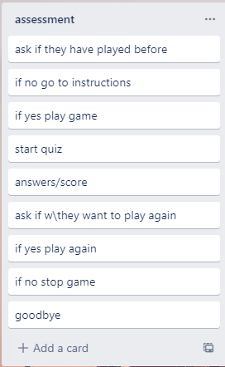
Decomposition:
Paste screenshots of your initial Trello board / task decomposition on this slide. If you have a long list, you might need to break it up into several slides.
The user/player will have to press <enter> for the game to start. the program will start the game by asking if u have played the game. if you say you haven’t it will print the instruction for you to read. If you say yes it will start the program/game.
It will ask you ten questions one at a time and after u have finished it will print a score showing u how u did out of ten.
After this the game will ask if the player want to play again. If the player says yes it will start over again. If the player says no it will end the program by saying goodbye
Notes:
Paste screenshots of your initial Trello board / task decomposition on this slide. If you have a long list, you might need to break it up into several slides.

Slide 5
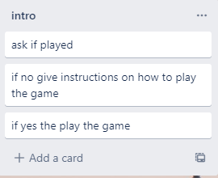


Introduction to the game (Trello screenshot)

Slide 6
[Component name] - Test Plan
Additional rows can be added by clicking in the last cell and then using the Tab key
Test Cases - input | Expected output
Notes:
Additional rows can be added by clicking in the last cell and then using the Tab key

Slide 7
[Component name]: Trialling
NOTE: Trialling needs to happen for at least 2 of your components but is not necessary for ALL components.
Trialling is not the same as testing. Trialling is about finding different ways of building the same component. Show evidence of your trialling here. Select one of your trials for further development and give reasons for your choice.
Notes:
NOTE: Trialling needs to happen for at least 2 of your components but is not necessary for ALL components.
Trialling is not the same as testing. Trialling is about finding different ways of building the same component. Show evidence of your trialling here. Select one of your trials for further development and give reasons for your choice.

Slide 8
[Component name]: Testing
You must show the results of testing. For each component, include a screenshot proving it works. You can also include notes about each test.
Notes:
You must show the results of testing. For each component, include a screenshot proving it works. You can also include notes about each test.

Slide 9
Assembled Outcome Testing:
Show testing for your assembled outcome below. This should include a test plan followed by screenshot proof.
Notes:
Show testing for your assembled outcome below. This should include a test plan followed by screenshot proof.

Slide 10
Address relevant Implications:
Relevant implication | Explain how your final outcome addresses each implication

Slide 11
Version Control Evidence:
Your version control evidence should go here. This could be in the form of screenshots (both of your GitHub repository as well as your local project folder) as evidence of your incremental development.
Notes:
Your version control evidence should go here. This could be in the form of screenshots (both of your GitHub repository as well as your local project folder) as evidence of your incremental development.

Slide 12
Final Discussion:
Discuss how the information from planning, testing and trialling of components assisted in the development of a high-quality outcome.
Notes:
Discuss how the information from planning, testing and trialling of components assisted in the development of a high-quality outcome.

